Slide 1
Spinnaker Analytics Topic: Predicting Used Car Prices
Aman Shaikh
May 2026

Slide 2
Agenda
Introduction
Project Objective
Overview of Dataset
Exploratory Data Analysis(EDA)
Data Preprocessing
Machine Learning Workflow
Algorithms Used
Model Evaluation Metrics
Model Selection(Final)
Conclusion

Slide 3
Introduction
The dataset contains information about used cars, including features such as brand, model year, fuel type, transmission type, kilometers driven, and price.
Used car prices are influenced by multiple factors such as car age, mileage, fuel type, vehicle condition, and brand value.
The project aims to analyze these factors and understand their impact on resale prices through data analysis and visualization.
Machine learning techniques are applied to identify patterns in the data and accurately predict used car prices.
This project helps demonstrate how data-driven approaches can support pricing decisions in the automobile market.

Slide 4
Project Objectives
To develop a machine learning model capable of predicting used car prices based on vehicle attributes.
To analyze how different factors such as mileage, car age, fuel type, and transmission affect resale value.
To perform data preprocessing, feature engineering, and exploratory data analysis for better understanding of the dataset.
To train and compare multiple regression models for accurate price prediction.
To evaluate model performance using metrics such as MSE, MAE, and R² Score.

Slide 5
Overview of Dataset
The dataset consists of used car records containing both numerical and categorical features related to vehicle specifications and pricing.
Key attributes in the dataset include company name, model year, fuel type, transmission type, kilometers driven, and vehicle price.
The dataset contains real-world information that helps analyze the relationship between vehicle characteristics and resale value.
Data preprocessing techniques were applied to handle missing values, convert data types, and prepare the dataset for machine learning.
Feature engineering was performed by creating new variables such as CarAge to improve prediction accuracy and model performance.

Slide 6
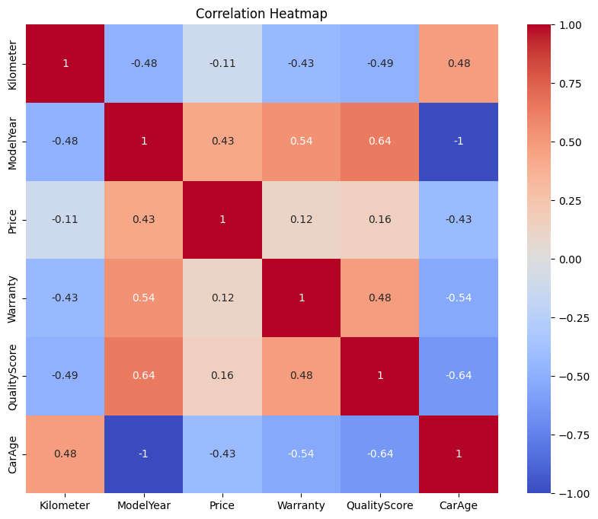
Relationship Between Vehicle Features and Used Car Prices

Slide 7
Exploratory Data Analysis (EDA)
Objectives of EDA:
-Understand used car price distribution
-Identify outliers and data patterns
-Analyze the impact of vehicle features on price
-Examine correlations between features and car price
Insights Gained: -Older and high-mileage cars have lower prices
-Automatic and premium cars tend to cost more
-Price distribution is right-skewed
-CarAge and Kilometer strongly affect resale price

Slide 8
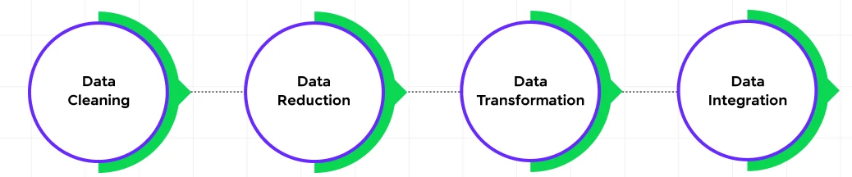
Data Preprocessing
Steps Performed:
-Handled missing values using appropriate imputation techniques
-Converted the Price column into a consistent numeric format for accurate analysis
-Encoded categorical features using One-Hot Encoding
-Applied feature scaling to normalize numerical variables
-Removed outliers and prepared clean data for machine learning model training

Slide 9
Machine Learning Workflow
Project Workflow
Problem
Statement
Data collection
EDA
Model Training & Evaluation
Model
Selection
Data Preprocessing

Slide 10
Algorithm Used
Linear Regression: Used as a baseline model to predict car prices by identifying linear relationships between features and the target variable.
Decision Tree Regressor: Used to capture nonlinear patterns and feature interactions within the dataset.
Random Forest Regressor: Used to improve prediction accuracy and reduce overfitting by combining multiple decision trees.

Slide 11
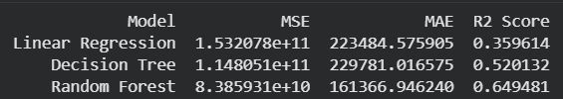
Model Evaluation Metrics
The following regression metrics were used: -MAE (Mean Absolute Error) – Measures the average difference between actual and predicted car prices -MSE (Mean Squared Error) – Penalizes larger prediction errors for better accuracy evaluation -R² Score – Indicates how well the model explains variations in used car prices -Residual Analysis – Helps evaluate prediction accuracy and identify model errors

Slide 12

Model Selection(final)
Multiple regression models were trained and compared to identify the most effective model for used car price prediction.
Performance comparison was based on evaluation metrics such as MAE, MSE, and R² Score.
The Random Forest Regressor achieved the best performance with the highest prediction accuracy and better generalization capability.
Therefore, Random Forest was selected as the final model for predicting used car prices.

Slide 13
Conclusion
Successfully developed a machine learning model for predicting used car prices using vehicle-related features.
Performed data preprocessing, exploratory data analysis, and feature engineering to improve model performance.
Compared multiple regression algorithms including Linear Regression, Decision Tree, and Random Forest.
Random Forest Regressor achieved the best performance with the highest prediction accuracy.
The project demonstrates the practical application of machine learning techniques in real-world price prediction problems.

Slide 14
Thank You!

